Slide 1
Context: Why did clustering prove handy?

Slide 2
Evolved campaign design & execution to drive key metrics
Drive margin
Drive activity
5
Reduced campaign cost
"Opt-in" to reduce cannibalization
Optimized reward depth to increase ROI
Drive response
Developed predictive models to increase relevance
Movie affinity
Product propensity
Introduced alternative channels
e-Mail
+ SMS
+ Social Media
3
1
Optimized campaign design
Refined hurdles, incentives and duration
Improved messaging and look & feel
Refined segmentation
Visit frequency is key driver
New segmentation reduces variance in results
4
Continuous process improvement reinforced our ability to execute and learn from results
2

Slide 3
Leveraged test and learn approach to evolve pilots
Pilot execution evolution
Key Learnings
Treatments
Tested different levels of hurdles and rewards
Hurdles of +2 visits hard to complete
Rewards >50pts likely to destroy value
Segments
Evaluated alternative segmentation approaches
Last 12-month visit frequency is key driver
Creatives
Simplified design based on consumer research
Straightforward / simple messages
Reward and image near top of msg.
Reward
type
Tested different rewards (2x1, free popcorn, none)
Tangible rewards (e.g. popcorn), attractive for low segment
Duration
Adj. duration based on each segments behavior
Short durations (<2 weeks) severely impact results of challenges
Analytical models
Product propensity model introduced
+ added business rules
Developed movie affinity model
Personalization of Movie & product reccos drives large increases in frequency
Opt-in
Introduced opt-in to reduce campaign cost
Essential to reduce cannibalization, particularly in flash offers
Channels
Introduced activation through SMS & Facebook
SMS increases "eyeball" reach
FB can be costly and hard to measure individual impact

Slide 4
Pilot populations were stratified by ‘frequency’ for measurement, as defined by preset business rules, to be compared against BAU or Control
Frequency Challenge
Design
High 1-9 visits per month
Difficulty / Reward | 50 points | BAU | Control
+1 visit in 2 weeks
+1 visit in 4 weeks
Medium 0.5 – 1 visits per month
Difficulty / Reward | 50 points | BAU | Control
+1 visit in 2 weeks
+1 visit in 4 weeks
Frequency Challenge v3.0
Treatment Group C
Low <0.5 visits per month
Difficulty / Reward | 50 points | BAU | Control
+1 visit in 2 weeks
+1 visit in 4 weeks
New Members (less than 6 months)
Difficulty / Reward | 50 points | BAU | Control
+1 visit in 2 weeks
+1 visit in 4 weeks
Lapsed Members
(no visits in 12 months)
Difficulty / Reward | 50 points | BAU | Control
+1 visit in 2 weeks
+1 visit in 4 weeks

Slide 5
Segmentation via clustering instead of business rules produced more statistically significant results in tests for margin, visitation
Fewer cells significant (blue) when sub-populations grouped by business rules
Re-segmentation produces higher statistical significance in per person gross margin lift.
Segment | BAU vs Control | Test vs Control | Test vs BAU
High
Medium
Low
Segment | BAU vs Control | Test vs Control | Test vs BAU
High | -6.2% @ 95% | 3.6% @ 95% | 10.5% @ 95%
Medium | -5.8% @ 95% | 4.0% @ 85% | 10.3% @ 95%
Low | -5.3% @ 95% | 2.9% @ 80% | 8.7% @ 95%

Slide 6
Frequency challenge update

Slide 7
Goal of customer segmentation Identify key behavioral levers that can drive customer revenue
Key drivers of customer revenue used to cluster
Frequency of visits
Customer Revenue
Ticket spending per visit
Spending per visit
Concession spending per visit
Factors for Clustering/Segmentation | Status
Frequency of Visits and Spending per Visit | V1.0 Complete
Total Spending, Tickets Spending and Concession Spend + breakdowns | Potential. Later Stage
Age, Gender, Geographic Location | Potential. Later Stage
Redemption Rate, Intervention Group | Priority. Later Stage

Slide 8
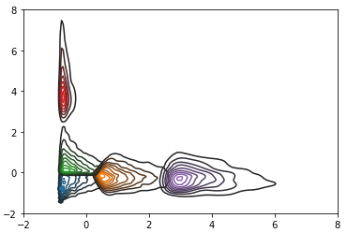
Segmentation approach is iterative, aiming to increase customer revenues by improving offer targeting
Current Progress in Segmentation
Clusters by spending and visit frequency.
Use KMeans to cluster initial groups
Visit Frequency
Spend per Visit
Identify ’proper’ number of clusters
Silhouette Score highest for 3 & 5
Execute Cluster Specific Statistics
Upper ranges of revenue in cluster
Gradient of individual observations
Re-cluster on subsets of population,
Include additional factors into clustering
1
2
Spending/Visit (Standardized)
3
Visits/Year (Standardized)
4
Note: Both axes centered & standardized. # Visits (x-axis), scaled to annual frequency
5 Clusters Selected.

Slide 9
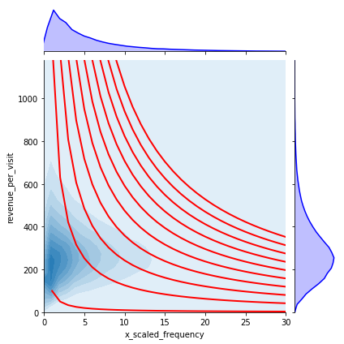
Further analysis into clusters and individuals shape offer personalization to increase revenue
Spending/Visit over Visits/Year
Broadly, Cinépolis’ offers are designed to target either:
Customer visit frequency
Or spending per visit
Gradient of revenue function can inform individual targeting: Does an offer to increase visits or $$$/visit maximize revenue?
Calculating function gradient identifies ‘direction’ that maximizes rate of revenue increase
Spending/Visit
Visits/Year
Red lines denote value frontiers for a customer’s annual revenue:
spending per visit * frequency

Slide 10
Analysis of clusters Statistics provides insights into segment elasticity
Visits/Year (Standardized)
Intra-cluster statistics can help us determine more optimal promotion hurdles.
Should our promotion reward require 4 or 5 visits?
Variance of clusters supply initial realistic range of behavioral elasticity:
How much spending can be increased per visit
How many visits is realistic for a member of this cluster
Next Phase: Integration of demographic variables will provide more granularity
Spending/Visit (Standardized)
Variable | Mean(Std) | Mean(Std) | Treatment B
Cluster Label | Visits/Year | $$$/Visit | Counts
0 - Red 1 - Purple 2 - Green 3 - Orange 4 - Blue | 2.4(1.9) 30.3(9.3) 2.6(2.0) 12.7(3.7) 2.85(2.3) | 795(896) 282(129) 388(63) 291(111) 196(69) | 24243 13838 61820 61741 102552
Notes:
Next Steps: Analysis by different demographic variables may enable more granular targeting (gender, age, loyalty tier)

